Slide 1


React JS
(the useeffect() hook)
Lecture-33

Slide 2
Today’s Agenda
Introduction To useEffect()
Syntax
Example
Use Of Dependencies Argument
Performing Clean Up

Slide 3
The useEffect() Hook
The useEffect() Hook allows us to perform side effects in our components.
Examples of side-effects are ajax requests, manipulating DOM directly, using timer functions like setTimeout(), and more.

Slide 4
The useEffect() Hook
The component rendering and side-effect logic are independent.
It would be a mistake to perform side-effects directly in the body of the component, which is primarily used to compute the output.

Slide 5
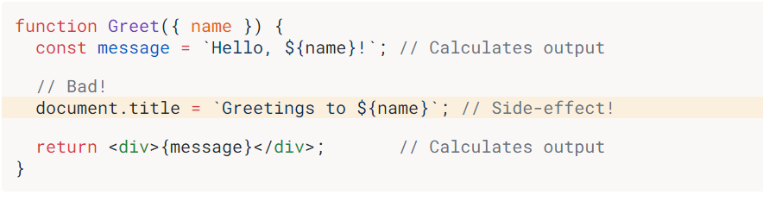
Bad Programming !

Slide 6
So What’s The Solution ?
So the next obvious question is how to decouple rendering from side-effect?
The answer is , by using useEffect() — the hook that runs side-effects independently of rendering.

Slide 7
Syntax Of useEffect()
The useEffect() hook accepts 2 arguments:
Syntax:
useEffect(callback[, dependencies]);
Following is the description of arguments:
callback is the function containing the side-effect logic and it is executed right after changes were being pushed to DOM.
dependencies is an optional array of dependencies and the useEffect() executes callback only if the dependencies have changed between renderings.

Slide 8
Exercise 1
Create a Functional Component which displays a button titled Increment Count and a counter initially set to 0
When the button is clicked the counter should increment by 1.
Also make sure that the counter value should also be displayed in the title bar

Slide 9
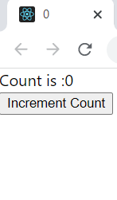
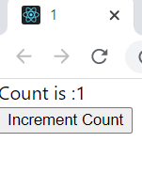
Desired Output
Before Click
After Click

Slide 10
Solution
MyCounter.js
import { useState, useEffect } from "react";
function MyCounter() {
const [count, setCount] = useState(0);
const incrementCount = () => {
setCount((prevCount) => prevCount + 1);
};
useEffect(() => {
document.title = count;
});
return (
<div>
<section>Count is :{count}</section>
<button onClick={incrementCount}>Increment Count</button>
</div>
);
}
export default MyCounter;

Slide 11
The Dependencies Argument
The dependencies argument of the hook useEffect() lets us control when the side-effect runs.
There are 3 possibilities:
No dependencies given
An empty array is passed as dependency
State or props are passed as dependency

Slide 12
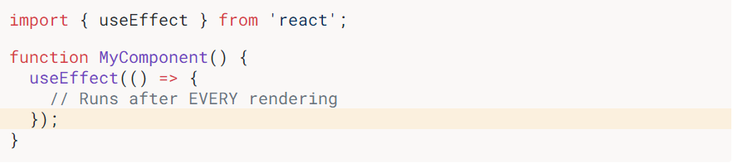
Case 1: No dependencies
If no dependencies are given then the side-effect runs after every rendering.

Slide 13
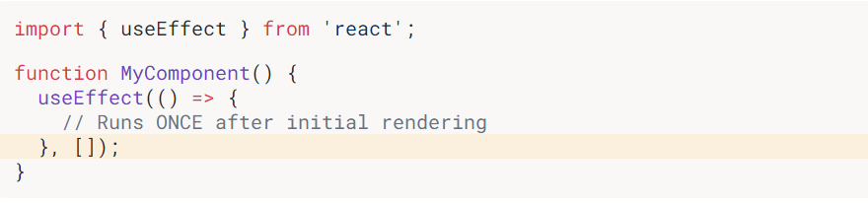
Case 2: Empty Array Passed
If an empty array is passed as dependency then the side-effect runs once after the initial rendering.

Slide 14
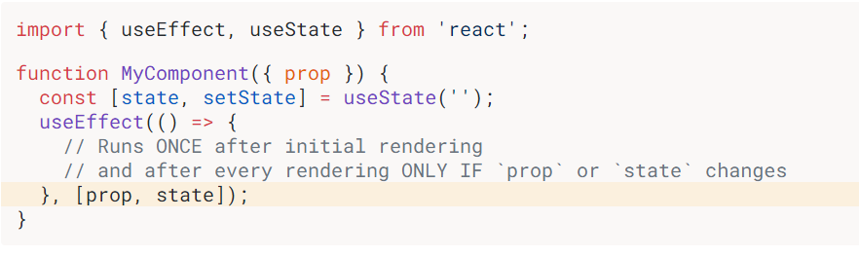
Case 3: State/Props Passed
If state or props are passed as dependency then the side-effect runs only when any dependency value changes.

Slide 15
Exercise 2
Create a Functional Component which resembles a Shopping App and displays 2 textboxes and a button .
In the first textbox the user will type item name and in the second textbox he will type item price
Now whenever the user clicks the button the new item must be displayed in the shopping list in the page , along with the previously entered items.
Also at the bottom display total number of items and total price

Slide 16
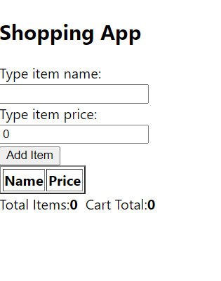
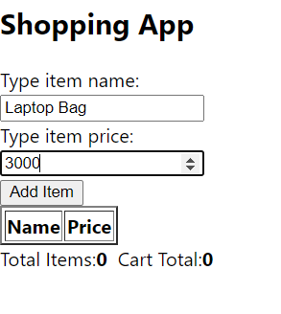
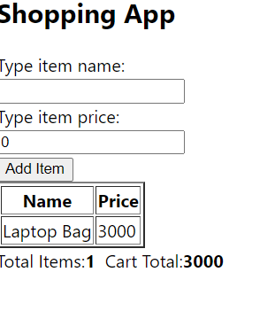
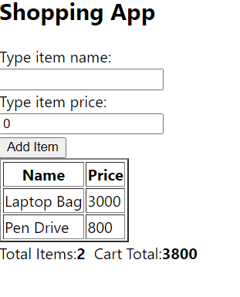
Desired Output
Before adding any item
After adding an item

Slide 17
Solution
Collection.js
import { useState, useEffect } from "react";
function Collection() {
const [data, setData] = useState({ name: "", price: 0 });
const handleNameChange = (event) => {
setData({ ...data, name: event.target.value });
};
const handlePriceChange = (event) => {
setData({ ...data, price: event.target.value });
};
const [items, setItems] = useState([]);
const addItem = (event) => {
event.preventDefault();
setItems([...items, data]);
setData({ name: "", price: 0 });
};
useEffect(() => {
let total = 0;
for (let item of items) {
total += Number(item.price);
}
document.querySelectorAll("b")[0].innerHTML = `${items.length}`;
document.querySelectorAll("b")[1].innerHTML = `${total}`;
}, [items]);

Slide 18
Solution
Collection.js
return (
<div>
<form onSubmit={addItem}>
Type item name:
<br />
<input type="text" value={data.name} onChange={handleNameChange} />
<br />
Type item price:
<br />
<input type="number" value={data.price} onChange={handlePriceChange} />
<br />
<button>Add Item</button>
</form><table border="2">
<thead>
<tr>
<th>Name</th>
<th>Price</th>
</tr>
</thead>

Slide 19
Solution
Collection.js
<tbody>
{items.map((item, index) => (
<tr>
<td>{item.name}</td>
<td>{item.price}</td>
</tr>
))}
</tbody>
</table>
<span>
Total Items:<b>0</b>
</span>
&nbsp;&nbsp;
<span>
Cart Total:<b>0</b>
</span>
</div>
);
} export default Collection;

Slide 20
Solution
App.js
import Collection from "./Collection";
function App() {
return (
<div className="App">
<h2>Shopping App</h2>
<Collection />
</div>
);
}
export default App;

Slide 21
Performing Clean Up
Some side-effects need cleanup: close a connection, clear timers.
If the callback of useEffect() returns a function, then useEffect() considers this as an effect cleanup.

Slide 22
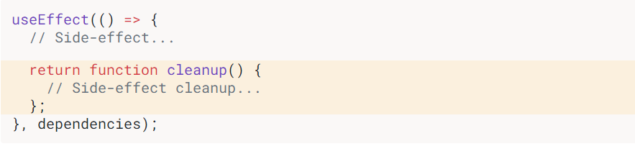
Performing Clean Up

Slide 23
How CleanUp Works ?
Cleanup works the following way:
A) After initial rendering, the useEffect() hook invokes the callback but cleanup function is not invoked.
B) On later renderings, before invoking the callback, the useEffect() hook invokes the cleanup function from the previous side-effect execution and then runs the current side-effect.
C) Finally, after unmounting the component, the useEffect() hook invokes the cleanup function from the latest side-effect.

Slide 24
Example
MyCounter.js
. . . . . .
useEffect(() => {
document.title = count;
return function cleanup() {
console.log("count is", count);
};
}, [count]);
. . . . . .
Output In Console:
================
On initial rendering the console will show nothing
On first button click , count will become 1 but console will show 0
which is the value of count from previous execution.
3. On second button click , count will become 2 but console will show 1
which is the value of count from previous execution.

